Slide 1

Comparing Methods to Predict Song Popularity
Shreyas Aswar, Sasha Heslin, Mukul Gharpure, Gummudala Hymavathi

Slide 2
Background
Music matters!
Can inform industry decisions in understanding what drives popularity and, thus, revenue.
Past studies have shown significance in this area as a whole (looking at genre
significant results (danceability, acounsticness, energy)
Little consensus, however
Music landscaping is changing, driving us to continue studying

Slide 3
Dataset: Spotify Songs (Nov 2018, April 2019)
Artist ID, Track Name, Track ID (removed)
Acousticness
Danceability
Energy
Instrumentalness
Key (1-9)
Liveness
Loudness
Speechiness
Time Signature
Valence
Duration
Popularity

Slide 4
Loading and Importing Dataset
Two sets of Spotify CSV files (2018 and 2019) with a total of 200,000 rows were downloaded, but due to time constraints, only 20,000 random values were used.
The data includes 17 columns, with "Popularity" as the response variable and the remaining columns as independent variables. There are 3 categorical variables, 11 continuous variables, and 3 string type variables.
Multiple libraries and packages were imported for data analysis and modeling.

Slide 5
Pre Processing
Duplicate entries were dropped from the dataset to eliminate redundant information.
Missing values were filled using the mean of the respective feature to retain as much data as possible.
Songs with a popularity score of zero were removed from the dataset
The duration of the songs was converted from milliseconds to seconds and trimmed to a reasonable length.
Three categorical variables( Key, Mode, Signature) were one hot encoded after its done Original variables were dropped.

Slide 6
Response Variable in Classification/Regression
In Regression, response variable ranges from 1 to 97.
In classification we have created two category Popular and Non- Popular.
The Categories were differentiated by median of the popularity variable.

Slide 7
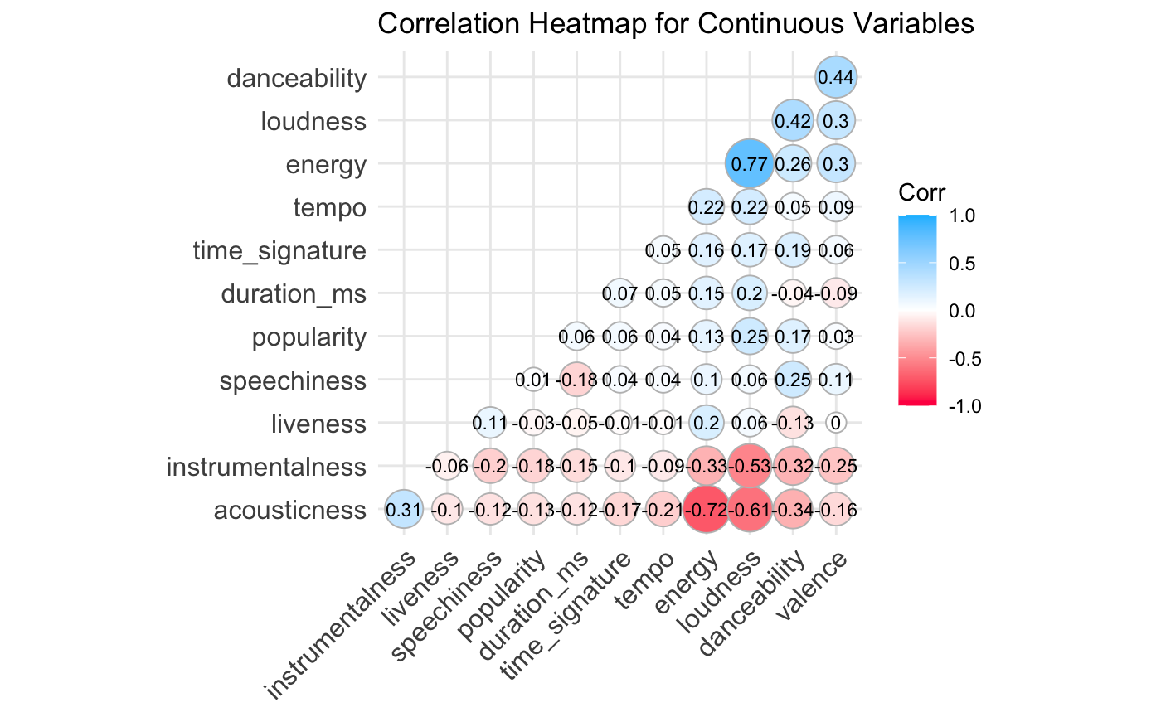
Normalizing the Data & Correlation Matrix
To address the issue of variables being on different scales,
the data was normalized using feature scaling
technique, specifically Standard Scaler.
After normalization, all variables ranged
between 0 to 1, making them more comparable.
A correlation matrix was used to determine
the degree of dependence between variables.

Slide 8
Methods: Regression
Objective: Predict song popularity using features such as danceability, energy, loudness, etc.
Models used: Linear regression, Decision Tree, Ridge regression, and Lasso regression.
Method: 10-fold cross-validation, with an 80-20 training-test data split, Seed= 42.
Evaluation metrics: Mean squared error (MSE), R-squared, and Adjusted R-squared.

Slide 9
Methods: Regression
Linear Regression:
R-squared: 0.0736586, Adjusted R-squared: 0.06544585, MSE: 0.9195855
Challenges: Limited predictive power and high error rate.
Ridge Regression:
R-squared: 0.07415323, Adjusted R-squared: 0.06594487, MSE: 0.9190945
Challenges: Regularization helped, but still insufficient in improving prediction accuracy.
Lasso Regression:
R-squared: 0.07388515, Adjusted R-squared: 0.06567441, MSE: 0.9193606
Challenges: Similar to Ridge, regularization improved the model, but not enough to make accurate predictions.

Slide 10
Methods: Regression
Decision Tree Regressor:
R-squared: 0.05699978, Adjusted R-squared: 0.04863934, MSE: 0.9361228
Challenges: Lower predictive power compared to other regression models, overfitting issues.
Key Takeaways:
Regression models struggled to predict song popularity from given features.
R-squared values were low (~0.07) for all models, indicating weak predictive power.
High MSE values (~0.9) suggest that the model's predictions were not very accurate.
High error rates and low R-squared values indicate the need for alternative approaches.

Slide 11
Methods: Classification
Why Classification ?
Results obtained from regression analysis were not satisfactory
We decided to pivot.
But what about Target Variable ( Response variable ) ?
Based on the Median of the variable - popularity
Two categories - Popular and Not Popular

Slide 12
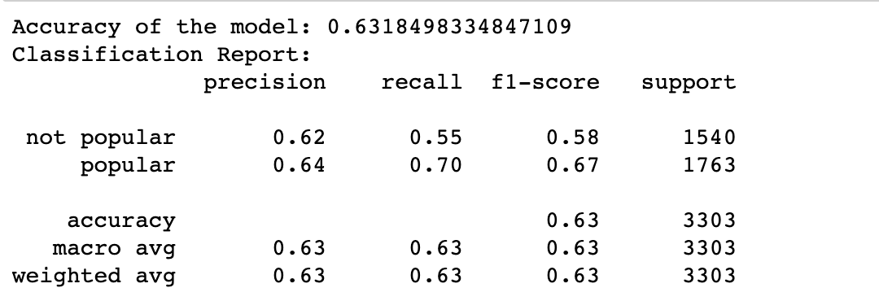
Methods: Classification Evaluation
Model Name | Accuracy
KNN (k=1) | 55%
KNN (k=3) | 56%
KNN (k=5) | 57%
QDA | 59%
LDA | 61%
Random Forest Classifier | 63.18%
Classification report for Random Forest Classifier:

Slide 13
Discussions
Is there really some ‘science’ involved in creating a popular song ?
We experimented with multiple Data Preprocessing, Modelling methods.
At least with the data we used and models we used for our analysis does not indicate the same.
Limitations and Areas of improvement
We could not use all the data which were available to us
Perhaps, more predictive variables should be considered while modeling like the instruments used, rhythm, harmony, melody, timbre
Developing methods to deal with influence in the songs due to various factors

Slide 14
Thank you!

